Slide 1



A Data-Driven Approach
AIRLINE DATA ANALYSIS

Slide 2
AIRLINE DATA ANALYSIS
I'm [Rohan Kaitake], and today, I'll be sharing insights from our recent airline data analysis project. We've focused on uncovering trends in flight performance, passenger demographics, and operational metrics to drive strategic decisions and enhance operational efficiency. Let's dive into the findings.

Slide 3
OPTIMIZING DATA PROCESSING AND VISUALIZATION
His project involves analyzing airline data to identify trends and optimize processes.
Objectives: Improve data processing efficiency, enhance data visualization, and derive meaningful insights.
Data Source: SQLite Database
Tools Used: Python, Pandas, SQLite, Matplotlib, Seaborn
DataSet

Slide 4
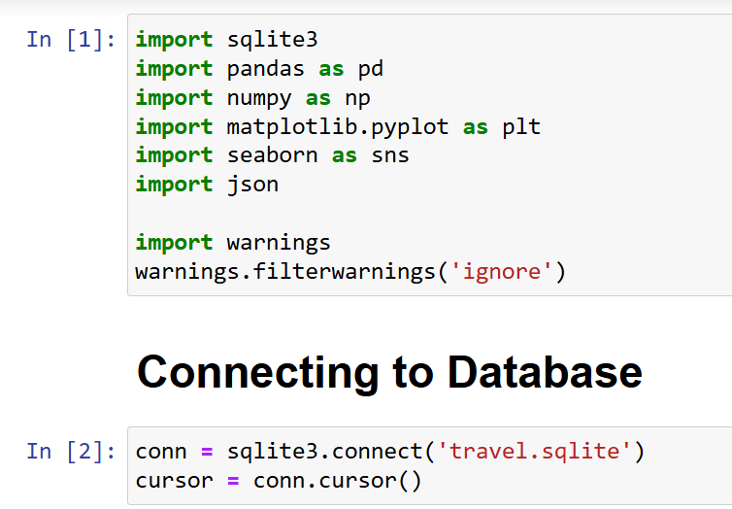
Data Loading and Extraction

Slide 5
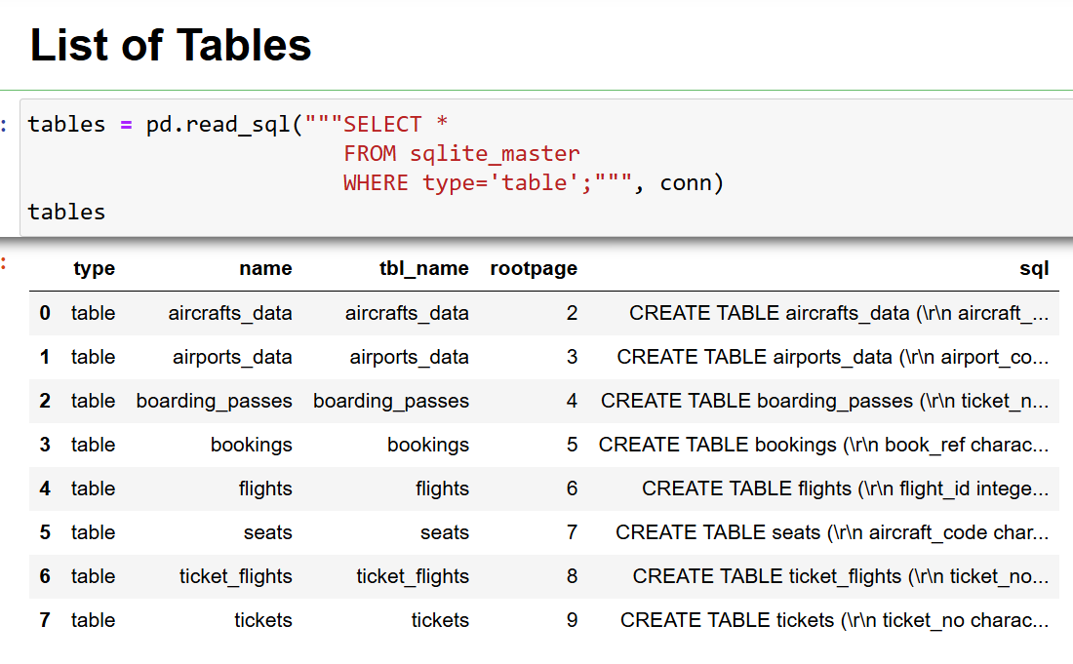

Slide 6
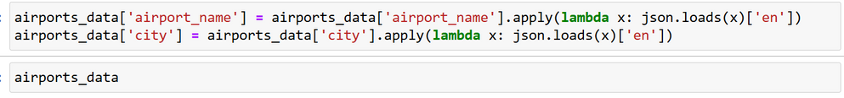


Data Exploration

Slide 7
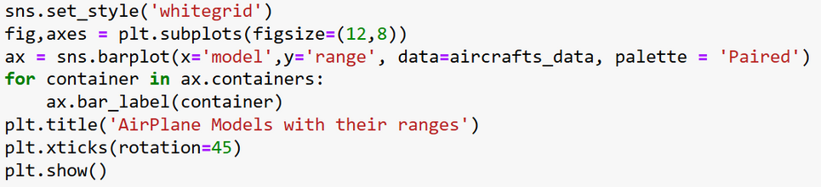
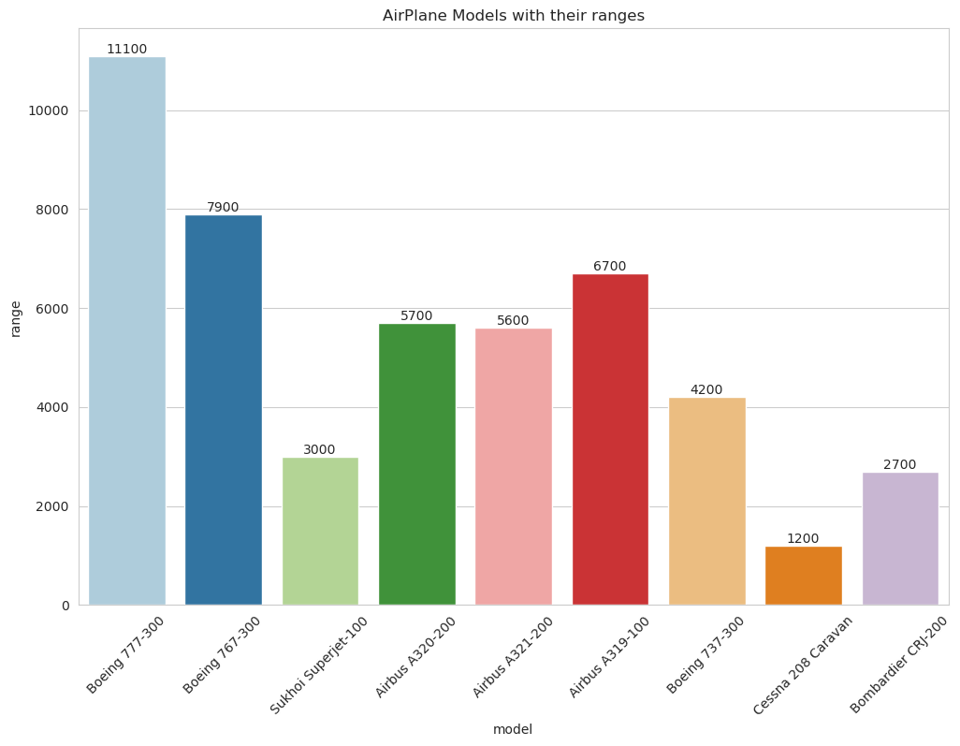
Data Visualization

Slide 8
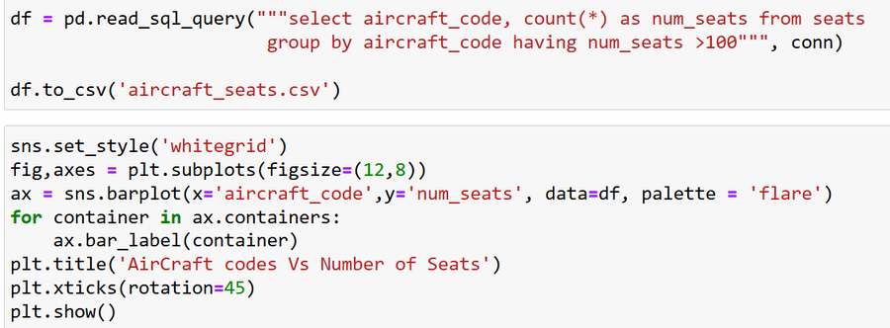
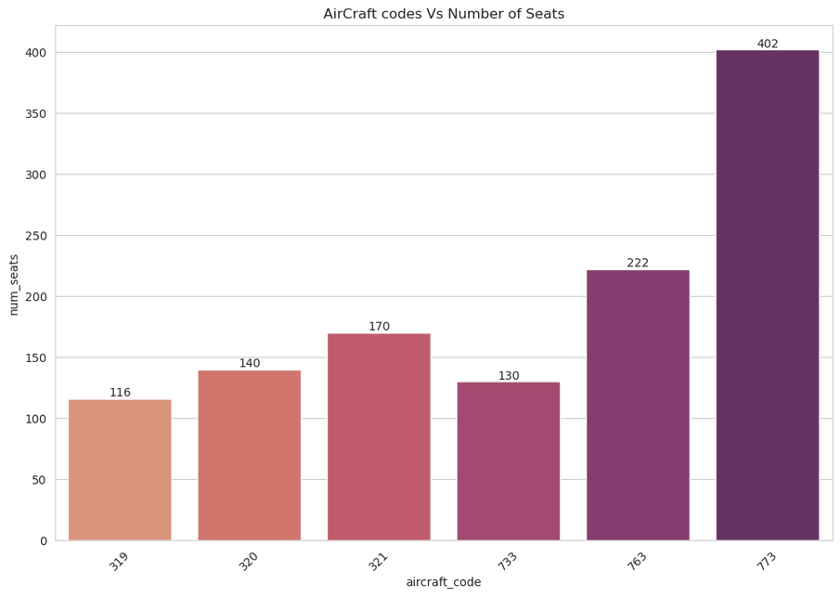
DATA ANALYSIS
Planes having more than 100 seats

Slide 9
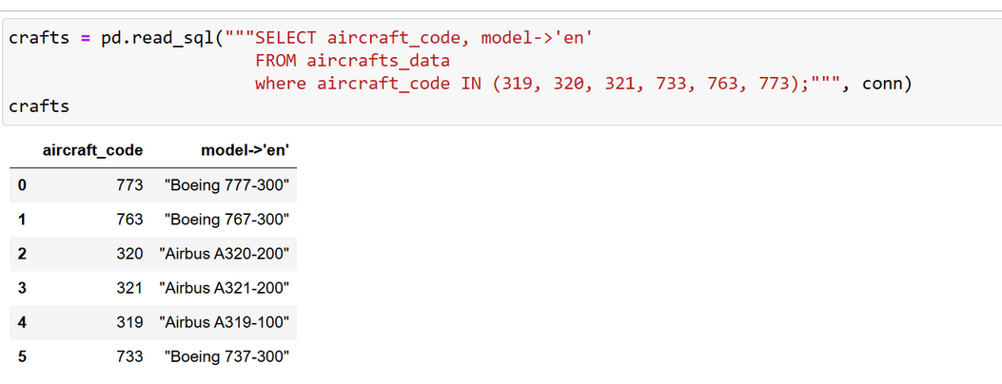
#Observation
Here we successfully derived the names of airplanes using their codes
So it seems like " Boeing 777-300 " is having maximum number of seats (402).

Slide 10
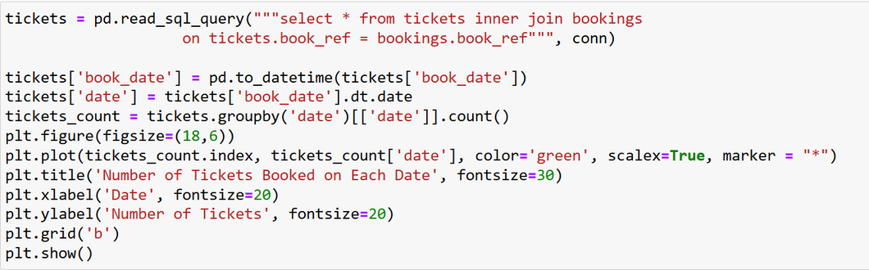
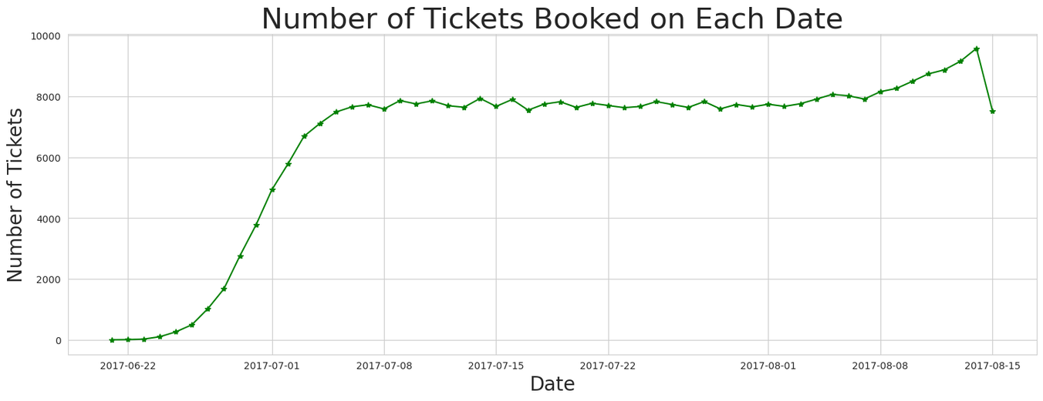
NUMBER OF TICKETS BOOKED AND TOTAL AMOUNT EARNED CHANGED WITH THE TIME

Slide 11
Observation
Utilized a line chart visualization to analyze the trend of ticket bookings and revenue earned.
The number of tickets booked showed a gradual increase from June 22nd to July 7th.
From July 8th until August, ticket bookings remained relatively stable with a noticeable peak in bookings on a single day.
The revenue earned by the company is closely correlated with the number of tickets booked.
The total revenue earned followed a similar trend throughout the analyzed time period
.
Further exploration of the factors contributing to the peak in ticket bookings could help increase overall revenue and optimize operational strategies.

Slide 12
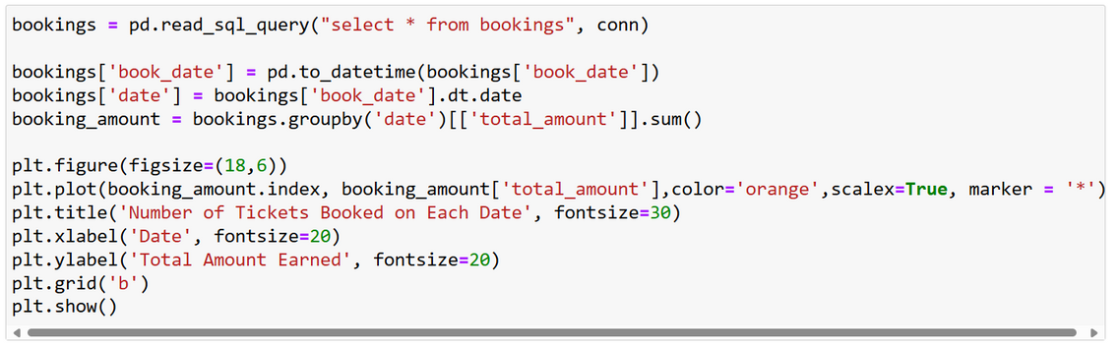
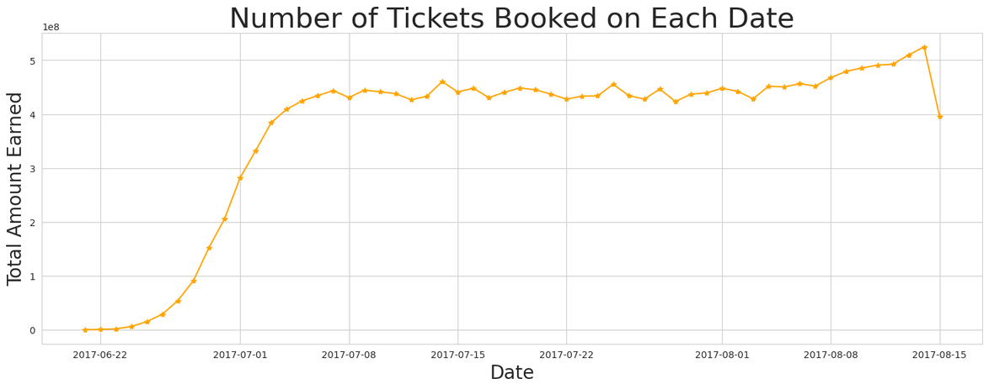

Slide 13
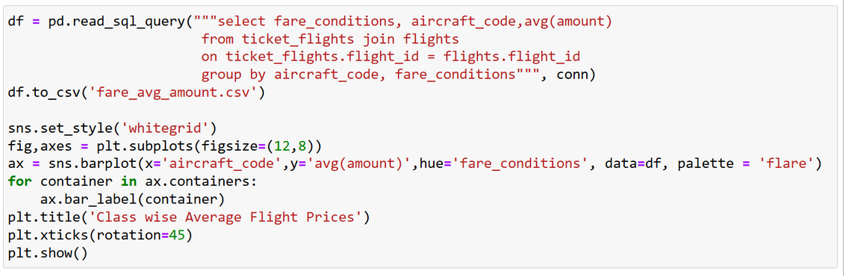
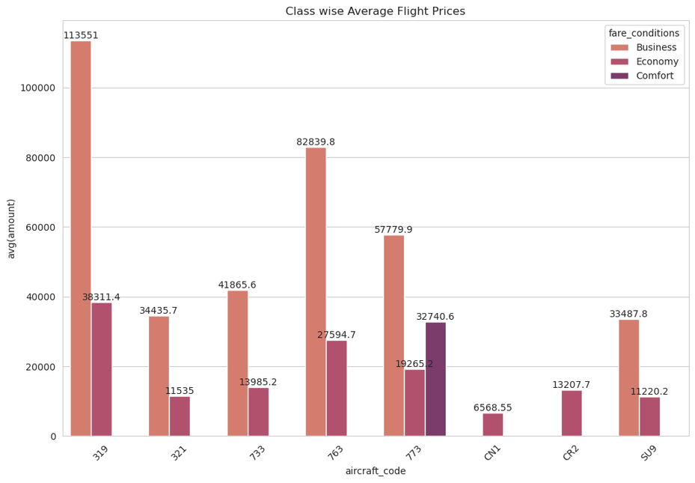
FARE DISTRIBUTION FOR THE FLIGHTS

Slide 14
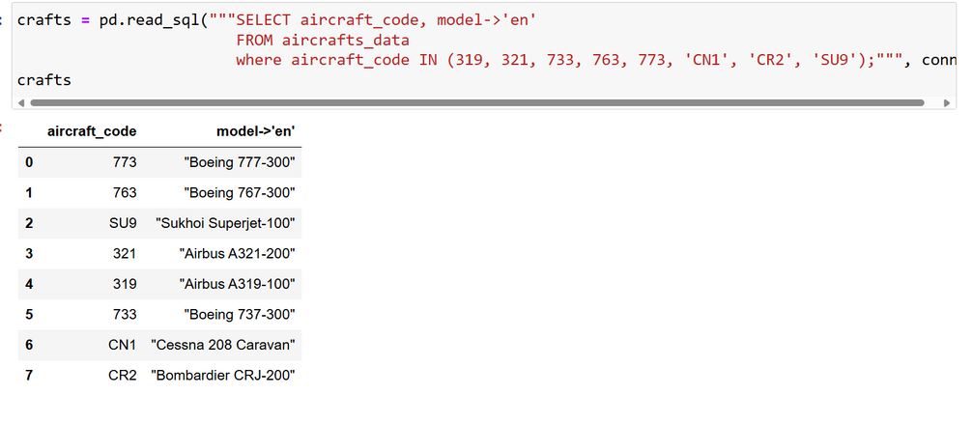
Observation
Here we successfully derived the names of airplanes using their codes
So it seems like " Airbus A319-100 " is having maximum average number of Business class seats.
Also " Airbus A319-100 " is having maximum average number of Economy seats.
And " Boeing 777-300 " is having maximum number of Comfort seats.

Slide 15
EXAMINING OCCUPANCY RATE
To maximize profitability, airlines must analyze revenue streams, including overall income, average revenue per ticket, and occupancy rates. This information helps identify profitable aircraft types, itineraries, and pricing optimization opportunities. The highest total revenue is generated by the SU9 aircraft, likely due to its lower ticket prices. The CN1 aircraft has the lowest total revenue, possibly due to its limited economy class offering. Monitoring average occupancy rates helps airlines fill seats efficiently, increase revenue, and reduce expenses. Improving occupancy rates can be financially beneficial and achieved through pricing strategies and operational considerations. Airlines should focus on optimizing pricing strategies for gradual revenue growth.

Slide 16
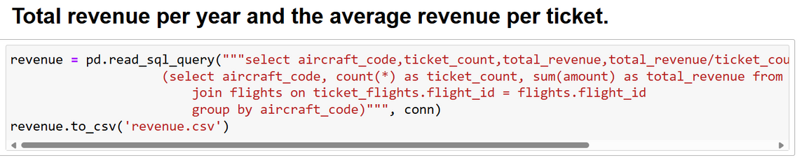

Slide 17
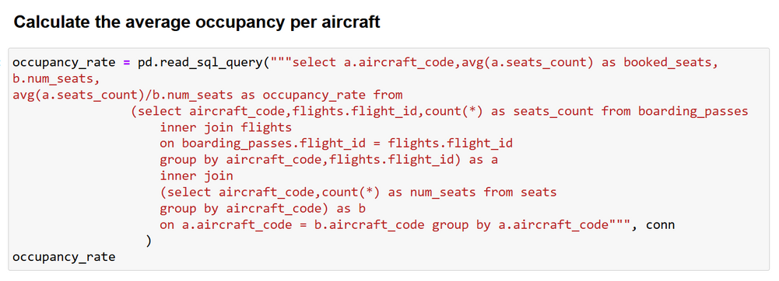
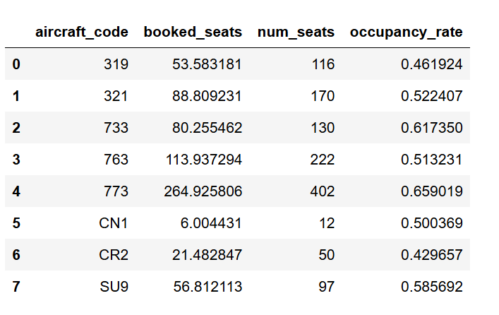

Slide 18
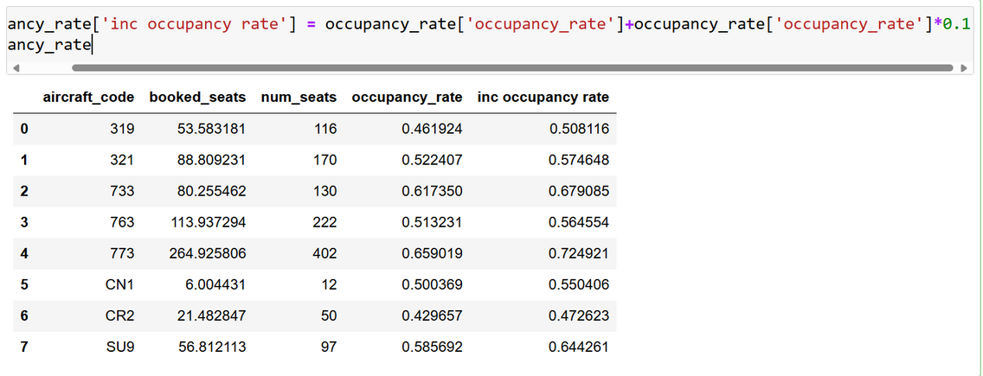
CALCULATING HOW MUCH THE TOTAL ANNUAL TURNOVER WOULD INCREASE BY GIVING ALL AIRCRAFT A 10% HIGHER OCCUPANCY RATE.

Slide 19
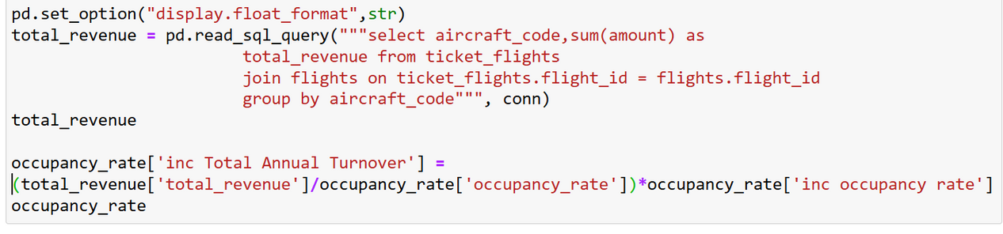
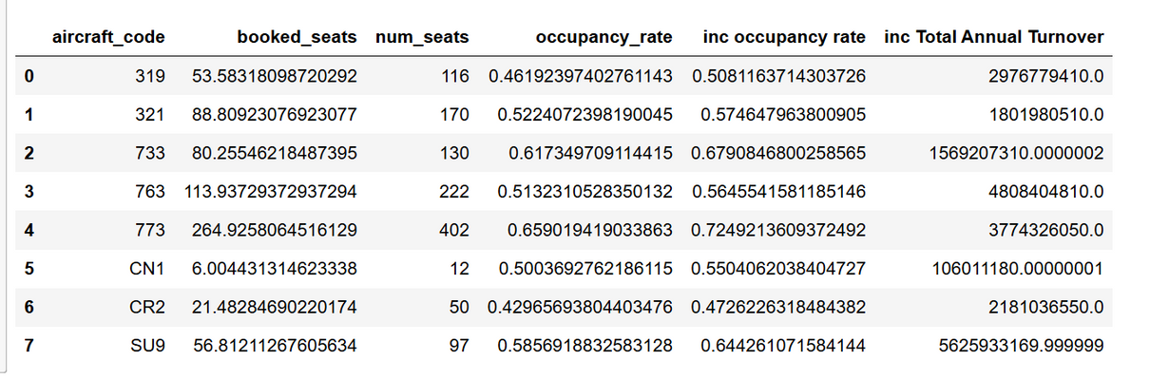

Slide 20
"OPTIMIZATIONS APPLIED"
CONTENT:
DATA LOADING: LOADED ONLY NECESSARY COLUMNS, OPTIMIZED DATA TYPES.
DATA CLEANING: VECTORIZED OPERATIONS, HANDLED MISSING VALUES EFFICIENTLY.
DATA PROCESSING: FILTERED AND PROCESSED DATA IN CHUNKS.
VISUALIZATION: USED EFFICIENT PLOTTING TECHNIQUES.

Slide 21
CONCLUSION
Key Findings:
Successfully optimized data loading by selecting only necessary columns and data types.
Efficiently cleaned data using vectorized operations and handled missing values.
Improved data processing through filtering and processing in chunks.
Enhanced data visualization with efficient plotting techniques, providing clear insights into long-range aircraft models.
Future Work:
Expand analysis to include more detailed passenger and flight data.
Implement machine learning models for predictive analysis.
Further optimize data processing algorithms for real-time data analysis.
Explore interactive visualizations for better user engagement and insights.
4o

Slide 22
THANK YOU
feedback

